Slide 1
Pet Care
by Rakshith Singh and Tom Clunie

Slide 2
Pet Obesity is an Epidemic!

Slide 3
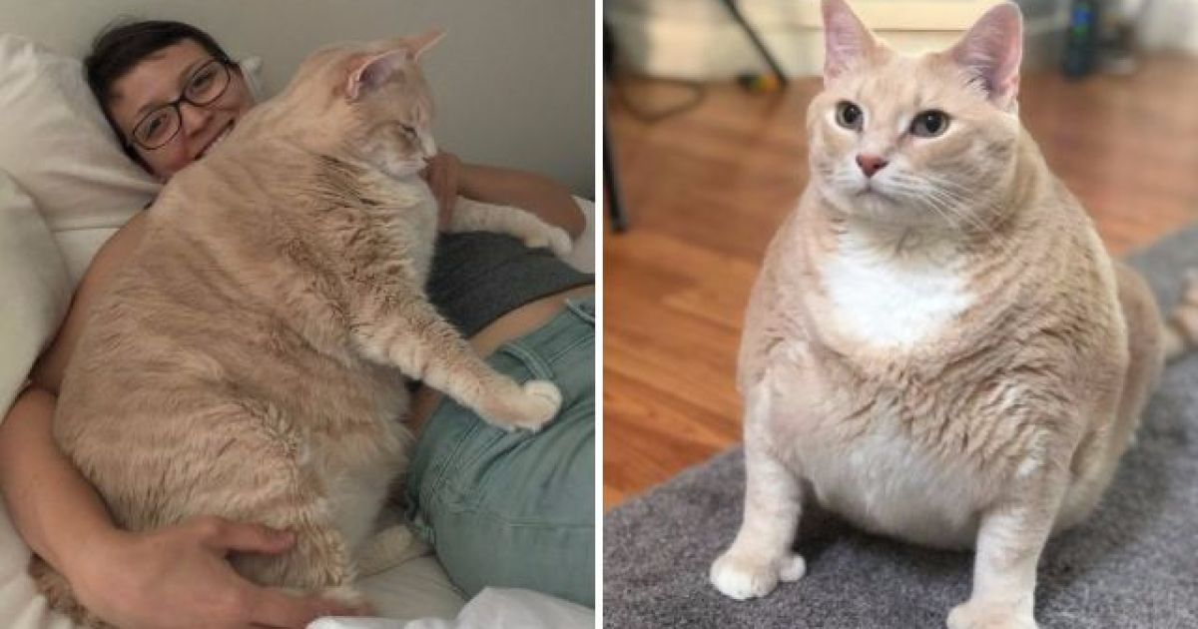

Slide 4
67% of American Households own a Pet ( ~84.9 Million homes ). Pet Industry is estimated to be worth around $62 Billion in 2020.
In 2018, an estimated 60% of cats and 56% of dogs in the United States were overweight or obese.
Dogs and Cats are considered overweight if they are at least 10%–20% heavier than their ideal weight.
Obesity in pets is associated with serious health conditions, such as
Cardiovascular disease
Joint Disorders
Metabolic abnormalities

Slide 5
Previous Works
As per our research, we found only one paper related to Cat Activity Prediction.
The authors used a custom made microcontroller equipped with a camera, accelerometer and GPS. Their prediction accuracy was not revealed and research was focused more on logging the cat’s everyday life and interactions.
Commercially available Pet “Fitness Trackers” are based on GPS and don’t provide any performance guarantees or metrics to measure accuracy.

Slide 6
Challenges
Due to travel and social distancing restrictions, we were unable to retrieve many pets for data collection and testing.
Data Collection on Pets is particularly challenging. Cats are notoriously lazy pets, but dogs on the other hand would be more active.
We had to be careful to avoid a skewed training dataset.
User App used Android’s Job Scheduler, which schedules our task at 15 mins intervals. This made testing our app inefficient and time constraining.

Slide 7
Proposed Solution
We developed a Smartwatch/Smartphone Activity Tracker for Pets which can -
Track and Monitor Pet activities throughout the day and store it in a database for analysis.
Provide an Active Monitoring feature to predict what your pet is up to in real time.
2 sets of Smartwatch and Smartphone Apps were developed (4 apps total)
Training Apps
Watch: collect sensor data every 1s
Phone: classify activity based on watch sensor data, store to CSV
User Apps
Watch: predict activity based on sensor data, accumulate stats
Phone: App for pet owners to view Pet Activity Stats, along with real-time activity

Slide 8
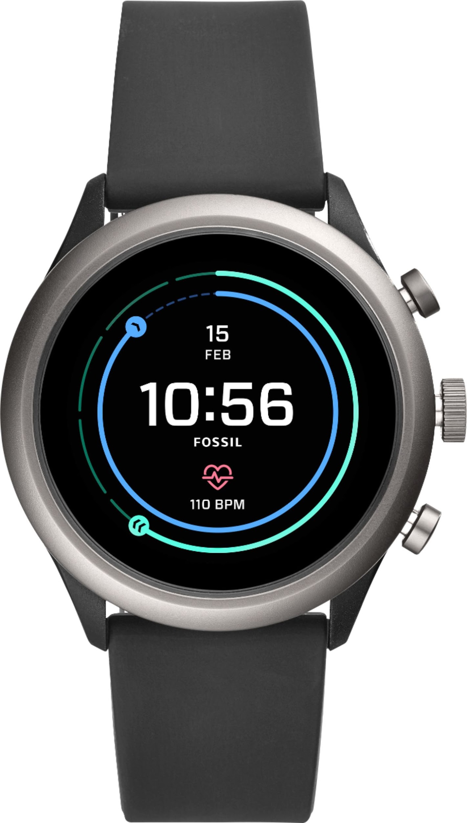
Architecture - Hardware, Software
and Sensors
Google Pixel 2 running Android 10.
Fossil Sport 4th Gen Smartwatch running Android’s Wear OS
Communication via WiFi and BLE
Linear Accelerometer and Gyroscope.
Android Studio SDK for App development.
Both Smartwatch and Smartphone applications ( User and Training ) were developed using Android API lvl 29.
Google Colab for Tensorflow model development

Slide 9
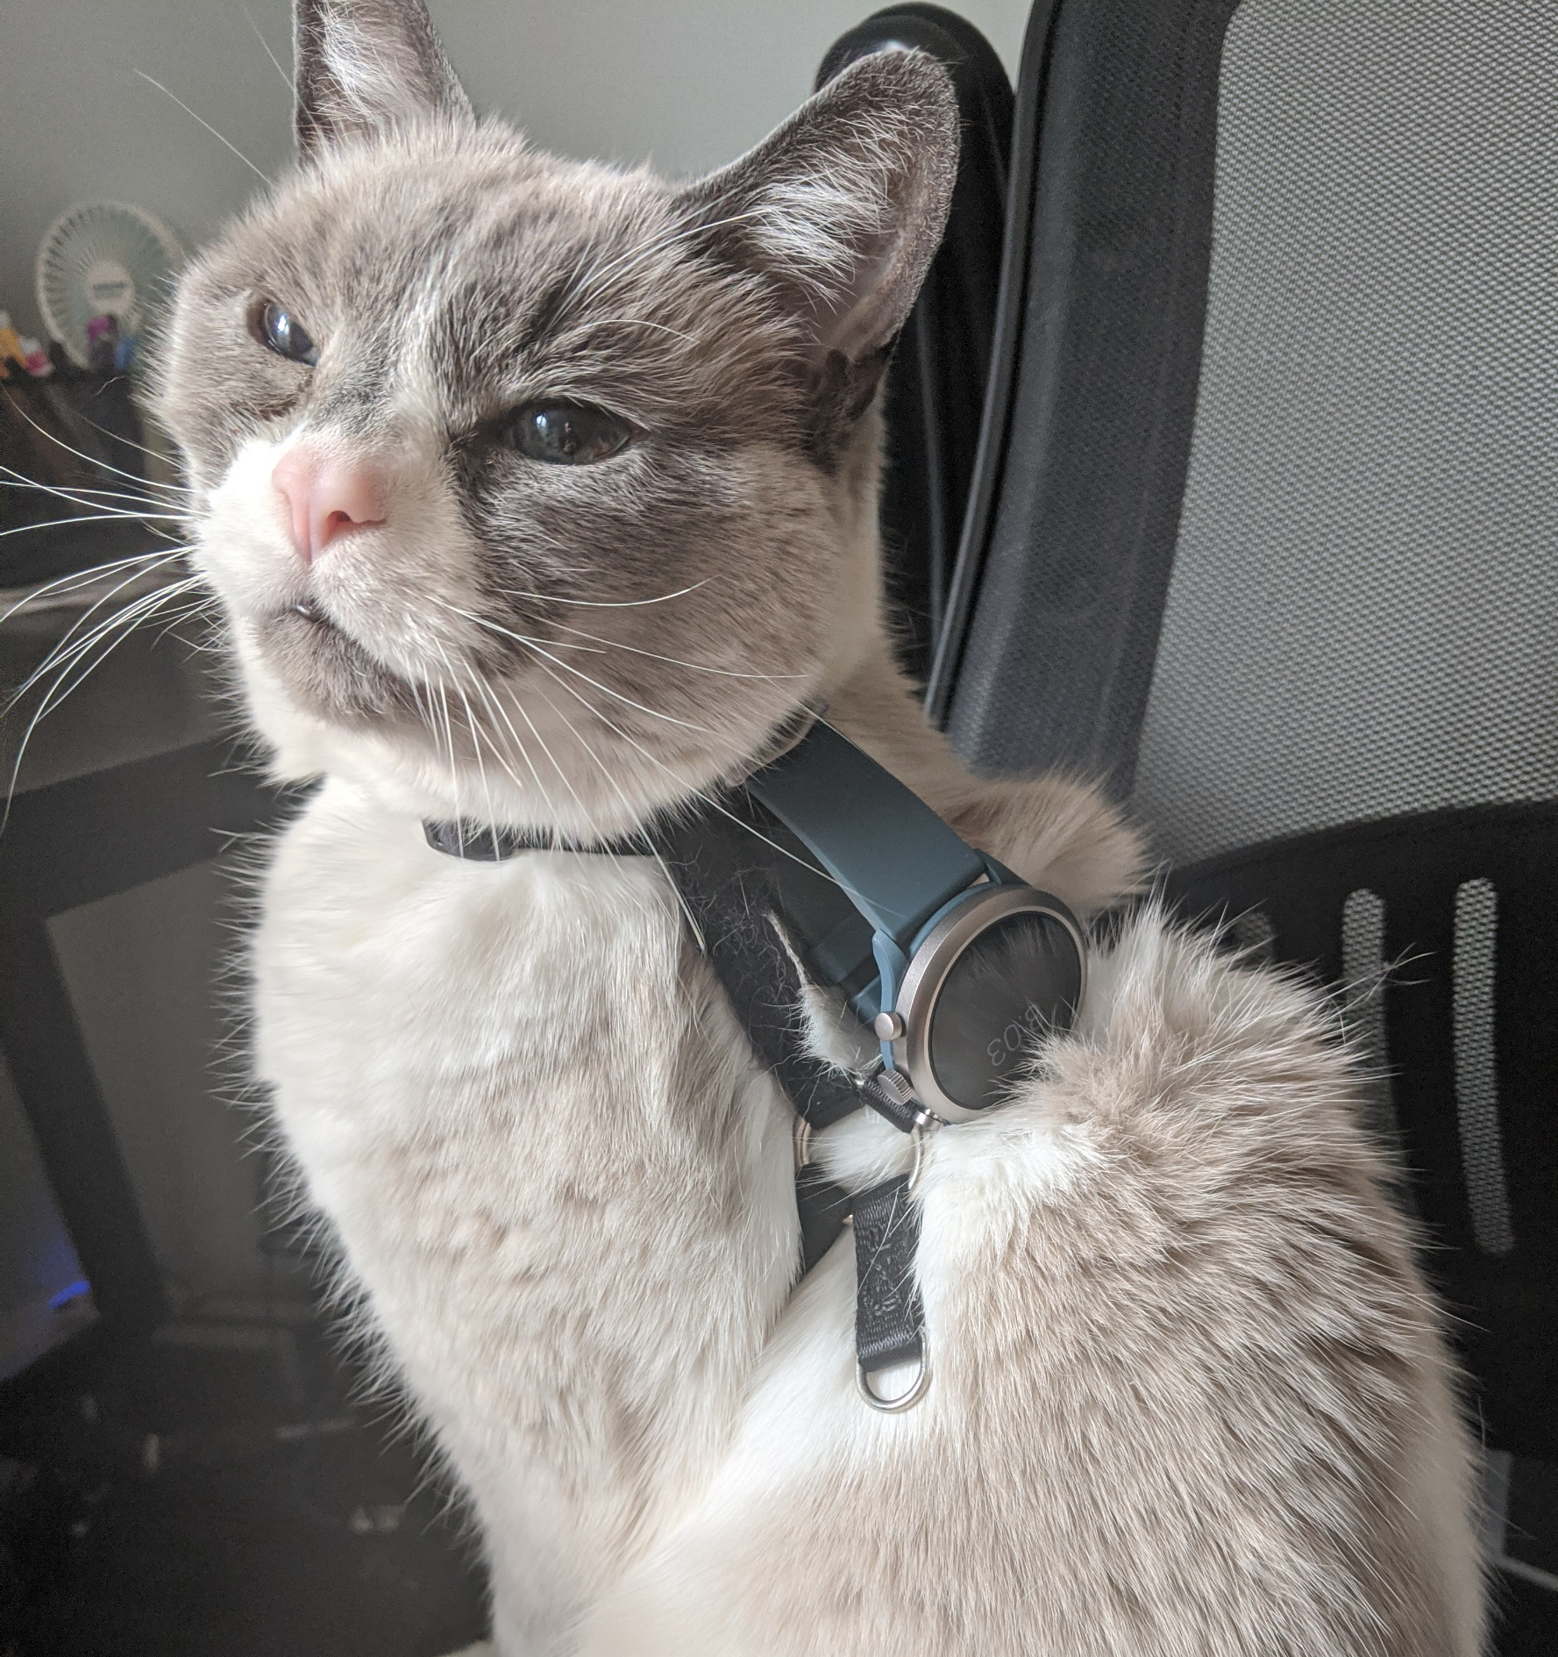
Test subject
“Gavin”
~13 year old male Snowshoe cat
Watch attached to harness using wristband

Slide 10
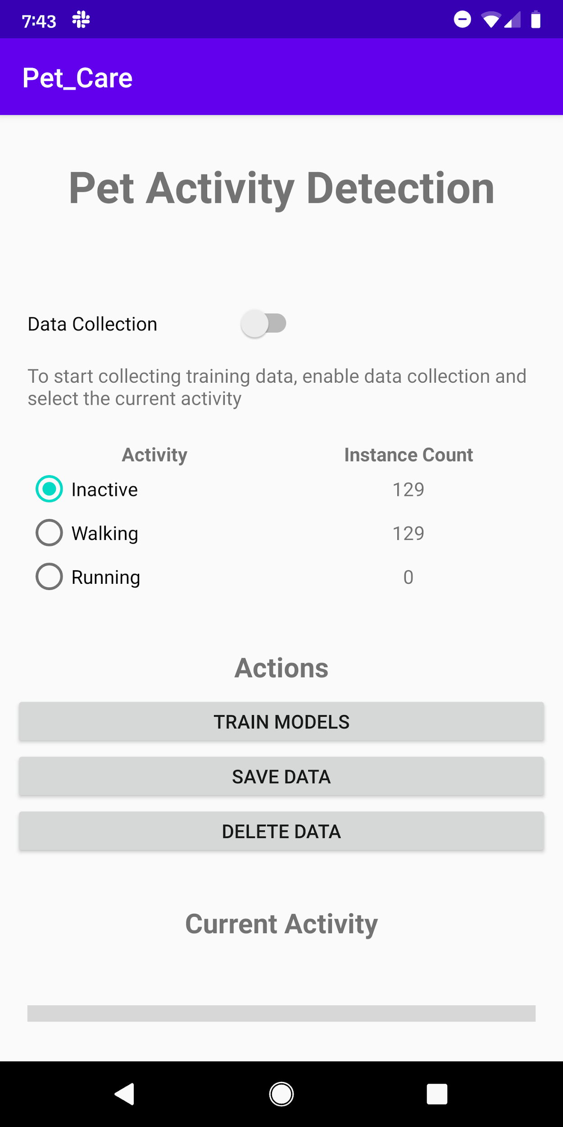
Training App
Based on Homework 2, smartphone app collected training data by communicating with the smartwatch.
Smartwatch sent Linear Accel and Gyroscope features every 1s
Smartphone stored data in CSV
Use CSV for training in Tensorflow

Slide 11
Data Collection Results
Based on HW2: send data to phone every second
12 attributes per sensor
Min, max, mean, var, stddev, zcr, mcr, energy, skew, kurtosis, centroid, rms
2 sensors
Linear accelerometer, gyroscope
Targeted 3 activity classes
Sleeping: multiple locations & positions
Moving: walking and running on flat surfaces and up/down stairs
Active, but not moving: looking around, standing, sitting while awake
30 minutes data collection for each class.
1824 samples, 1 second each
~600 samples per class

Slide 12
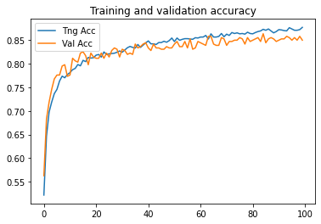
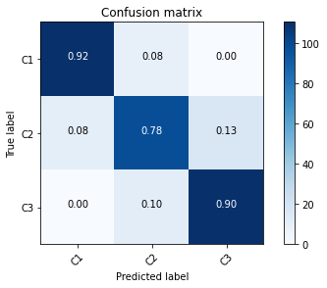
Tensorflow training
Created Keras model on Google Colab
Single hidden layer with 32 units, softmax output, 927 parameters
TF-Lite model size = 4.8KB
Some difficulty distinguishing “Active but not moving” class vs others
Training challenges
Need better definition of “Active but not moving class”
Better TF model
Observed negligible impact when deployed
Classes:
C1: Sleeping
C2: Active/not moving
C3: Active/moving

Slide 13
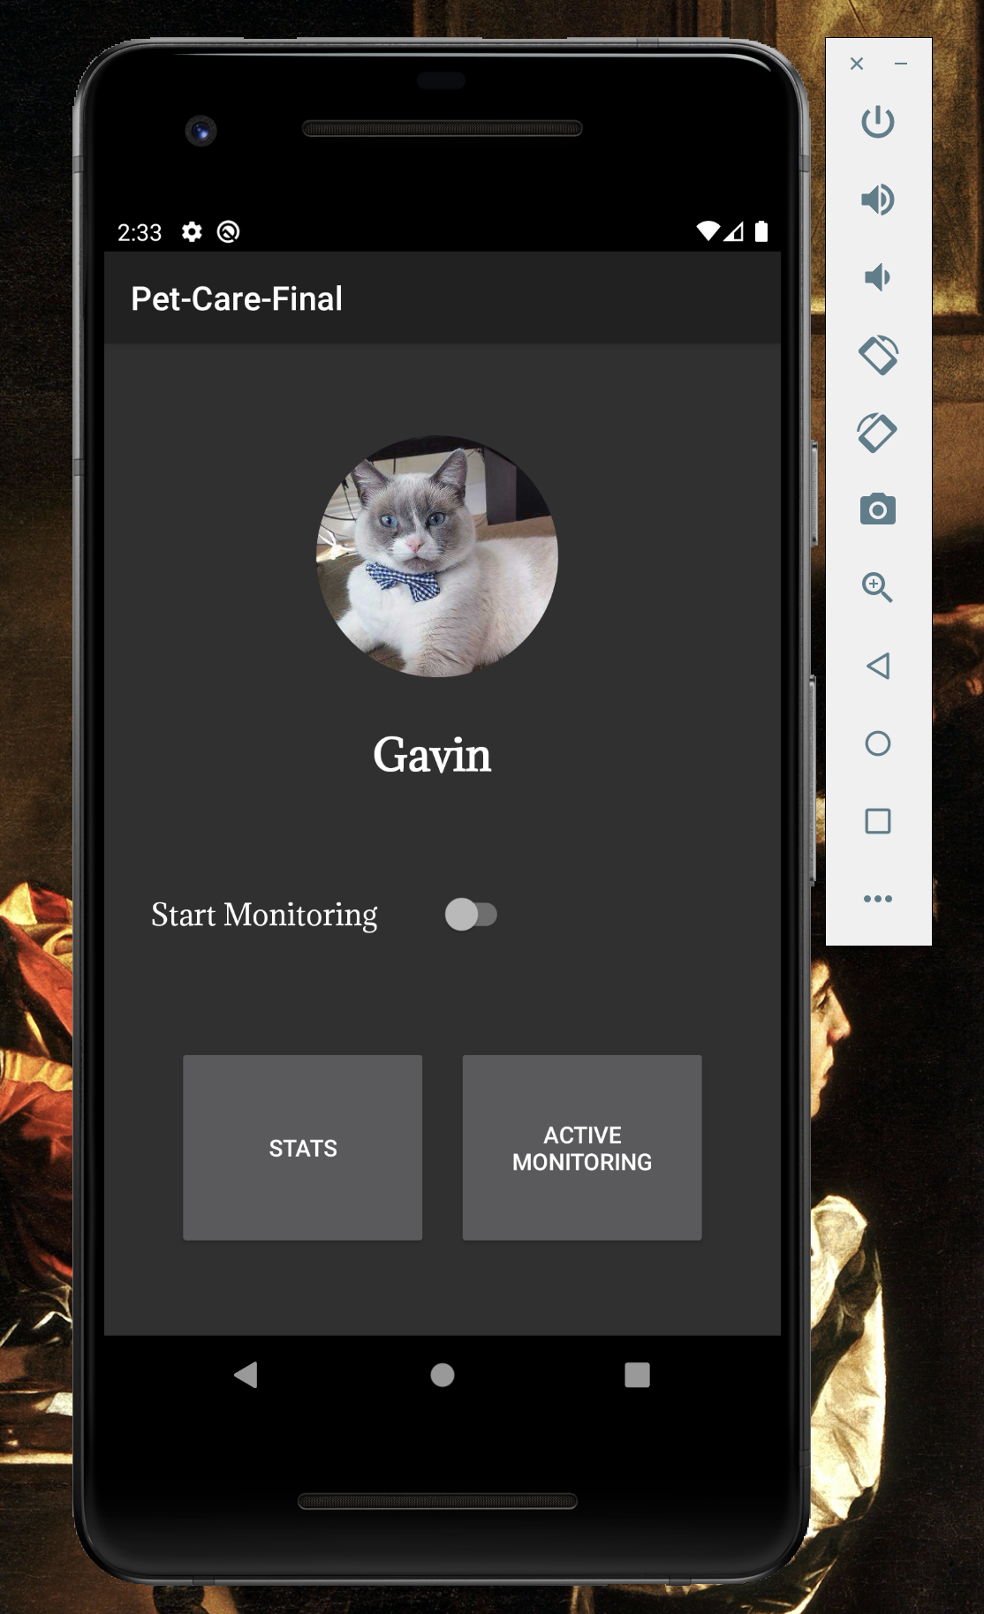
User App - Smartphone
Monitor Switch to turn on and off Activity Monitoring - Monitoring conducted in the background using Android Job Scheduler.
Job scheduled every 15 mins, to communicate with Smartwatch and collect prediction dump.
Predictions and its analysis stored in SQLITE Database on the smartphone.
Stats button launches a new activity to display the Activity Statistics Pie Chart.
Active Monitoring launches a new activity to display Real Time pet activity predictions.

Slide 14
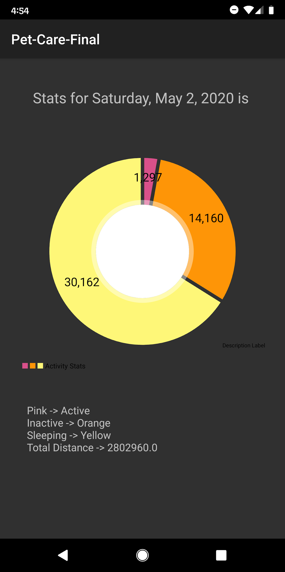
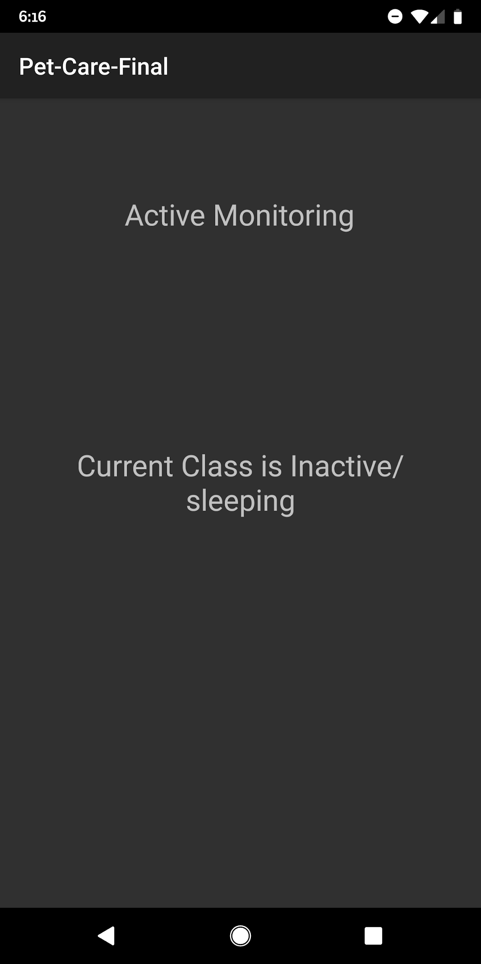
Stats Activity and Active Monitoring Activity

Slide 15
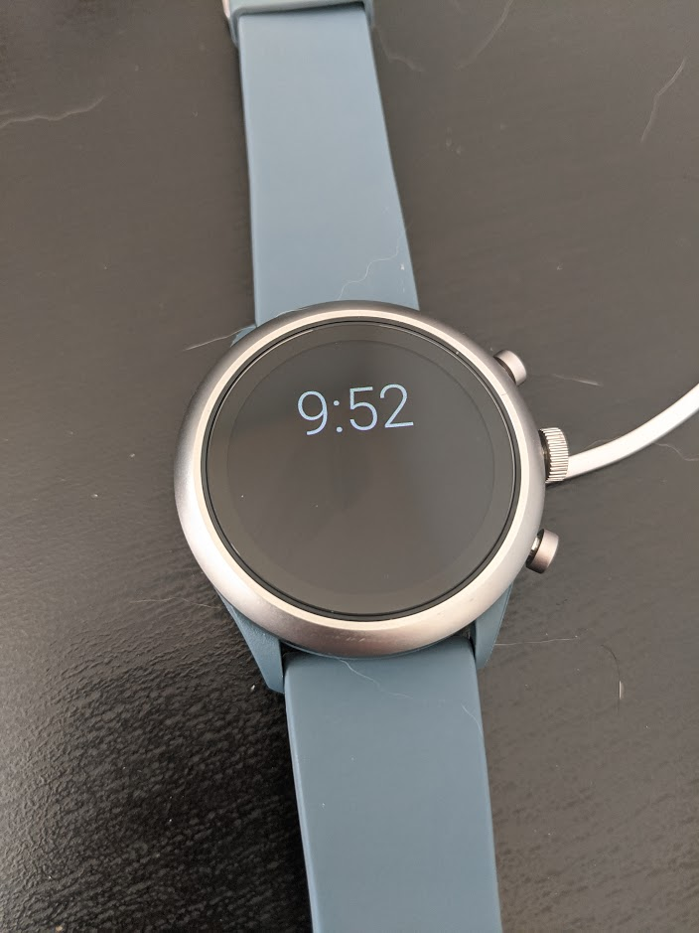
User App - Smartwatch
Implemented as custom watch face
Android provides tick event every minute, useful for intelligent power management
Performs inference locally, stores statistics temporarily
Responds to requests from phone:
Accumulated statistics
Current activity
Manages device/sensors power state

Slide 16
Deployment of TF-Lite Model
Problem: both devices can run TF-Lite model, so where should it be done?
Watch resources (memory, battery) are limited compared to modern smartphone
Sensor data: ~0.4KB/sec of sensor data = ~1.4MB/hour
Watch can be disconnected from phone for many hours
Watch needs a way to manage power
Solution
Run activity prediction on the watch
Store total time for each class locally, push to phone on demand
No need to store sensor data, just predict class and accumulate
Inference benchmark: < 0.1ms
Can use activity class for power management

Slide 17
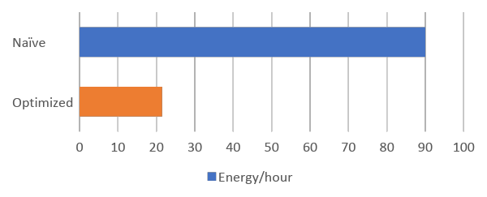
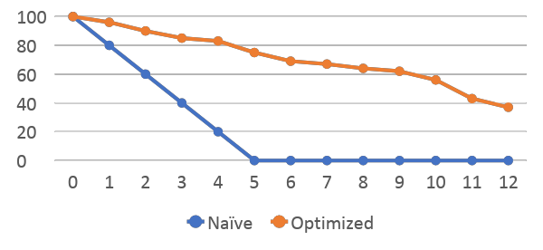
Watch energy optimization
Problem: 4-5 hour watch life with naïve implementation
Solution:
Cat sleeps more than half of the day, so power down to save energy
Use native Android trigger to “wake up” when movement detected
Use partial wakelock to keep sensors active at 1s intervals
Use local inference to detect 5 minutes of inactivity, then disable sensors
Result:
Energy reduced from ~90mA/hr to 21.5 mA/hr
Additional improvements possible with coarser classification (>1s) at cost of accuracy
Battery Consumption (mA/hr)
Battery% vs time (h)

Slide 18
Results
We monitored Gavin for a total of 12.5 hrs on
May 2nd between 12am and 12:30pm
We observed that Gavin spent
30k seconds ~ 8.3 hrs Sleeping
1.3k seconds ~ ½ hr Active
14k seconds ~ 3.9 hrs Inactive
Total distance covered was ~ 0.7 Miles ( 80cms/s * Active Time ( in seconds ).

Slide 19

Demo 1 – Inactive to active, and back

Slide 20
Demo 2 – Sleeping

Slide 21
References
https://www.americanpetproducts.org/press_industrytrends.asp
https://petobesityprevention.org
https://www.aaha.org/publications/newstat/articles/2020-02/pet-obesity-is-an-epidemic/
https://rekimotolab.files.wordpress.com/2009/11/154-catlog.pdf

